Slide 1
Using Simulink for Model-Based Simulations
Timothy Kyung
UC Irvine
05/25/2023

Slide 2
We need to shift verification left
Where errors are introduced (yellow) vs. detected (blue)
Source: Clive Maxfield and Kuhoo Goyal “EDA: Where Electronics Begins”

Slide 3
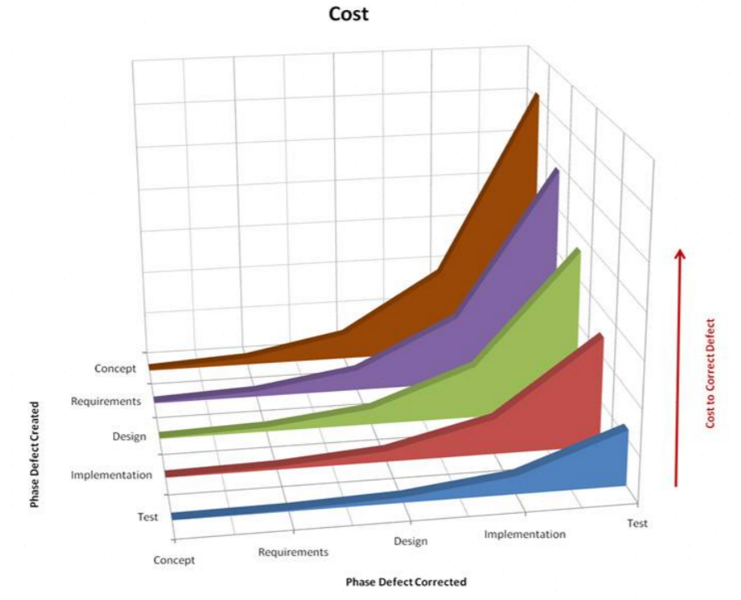
Why is developing complex systems expensive?
Cost
Concept
Cost to Correct Defect
Requirements
Phase Introduced
Design
Implementation
Test
Test
Design
Implementation
Concept
Requirements
Phase Detected
Source: Return on Investment for Independent Verification & Validation, NASA, 2004.
Notes:
https://www.nasa.gov/centers/ivv/pdf/398308main_Value%20Report%20Final.pdf

Slide 4

Traditional Development
Requirements and specifications
RESEARCH
REQUIREMENTS
Requirements are captured in text and may be ambiguous
SPECIFICATIONS
Design and implementation
Subsystems are often developed independently
Mechanical components
Embedded software
Physical prototyping is expensive!
DESIGN AND IMPLEMENTATION
Code is often hand-written
C/C++
Control
Design
MCAD/ MCAE
EDA
Embedded Software
Control Algorithms
Mechanical Components
Electrical Components
Problems are undiscovered or discovered late, when they are costly to fix.
INTEGRATION AND TEST
Notes:
This is a natural way to solve an engineering problem. First research and state requirements, then we have a meeting to make sure that we’re all on the same page. We break the huddle, separate into teams, and each team builds its subsystem. Then we combine the subsystems in a prototype and test it.
But there are some problems with this plan.
It’s difficult for engineers to compare their design to the specifications because they are not integrated with the design process. The model and requirements are disconnected, so it can be challenging to recognize whether the current design still satisfies the requirements.
Since the teams are more or less siloed and much of the testing happens near the end of the process, there are many opportunities for defects to appear. Prototypes are costly. Using domain-specific modeling environments precludes system-level simulations, so these tests have to wait until the prototyping stage.

Slide 5
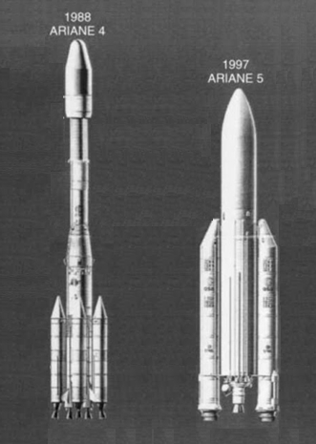
Ariane
Ariane 5 design and test
~2X payload

Slide 6
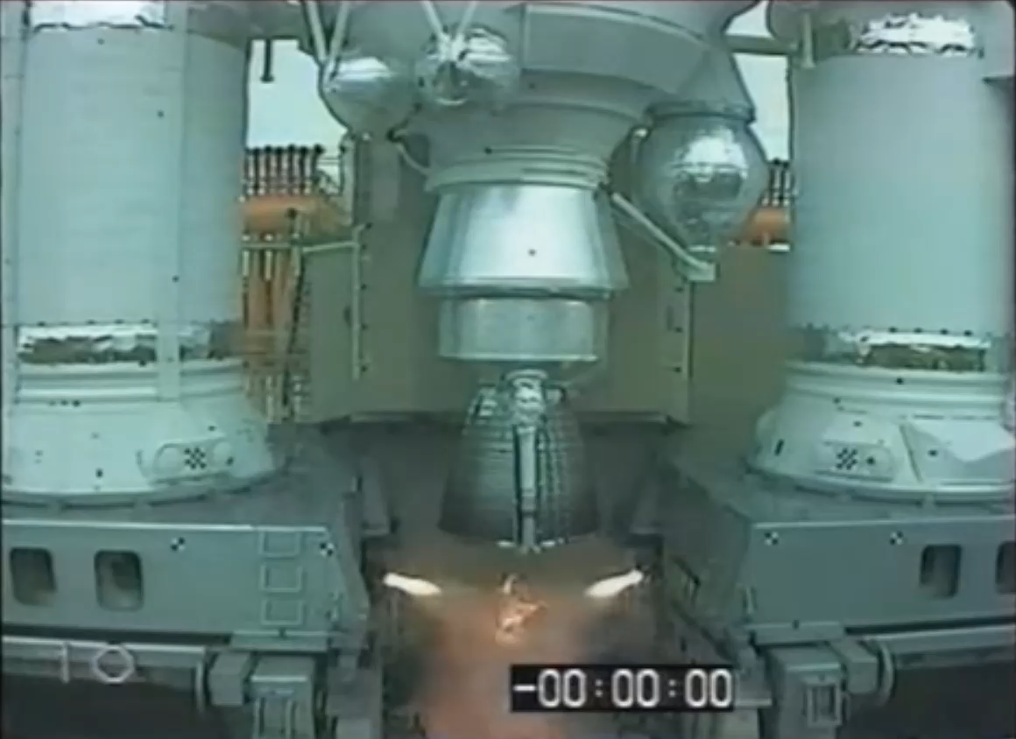
Ariane
Notes:
The crash, triggered by the ground crew, was attributed to an overflow. The controls software on Ariane 5 was recycled from the smaller Ariane 4. Its rocket motor actuators had a larger range of motion. Physical signal inputs, no longer constrained to the bounds that applied to the smaller rocket, caused an overflow on the controller.
The Ariane 5 inherited requirements from its predecessor. The design process followed the path: Requirements -> Model -> Test/Integrate/Build. Finally, long after modeling and testing, a change was made to the hardware. Had this change been evaluated in a model that also served as an executable set of requirements, this failure mode may have been found before flight.
MBD allows modeling of not just the physical system, but also logic (like the controls algorithm) and fixed-point behavior.

Slide 7
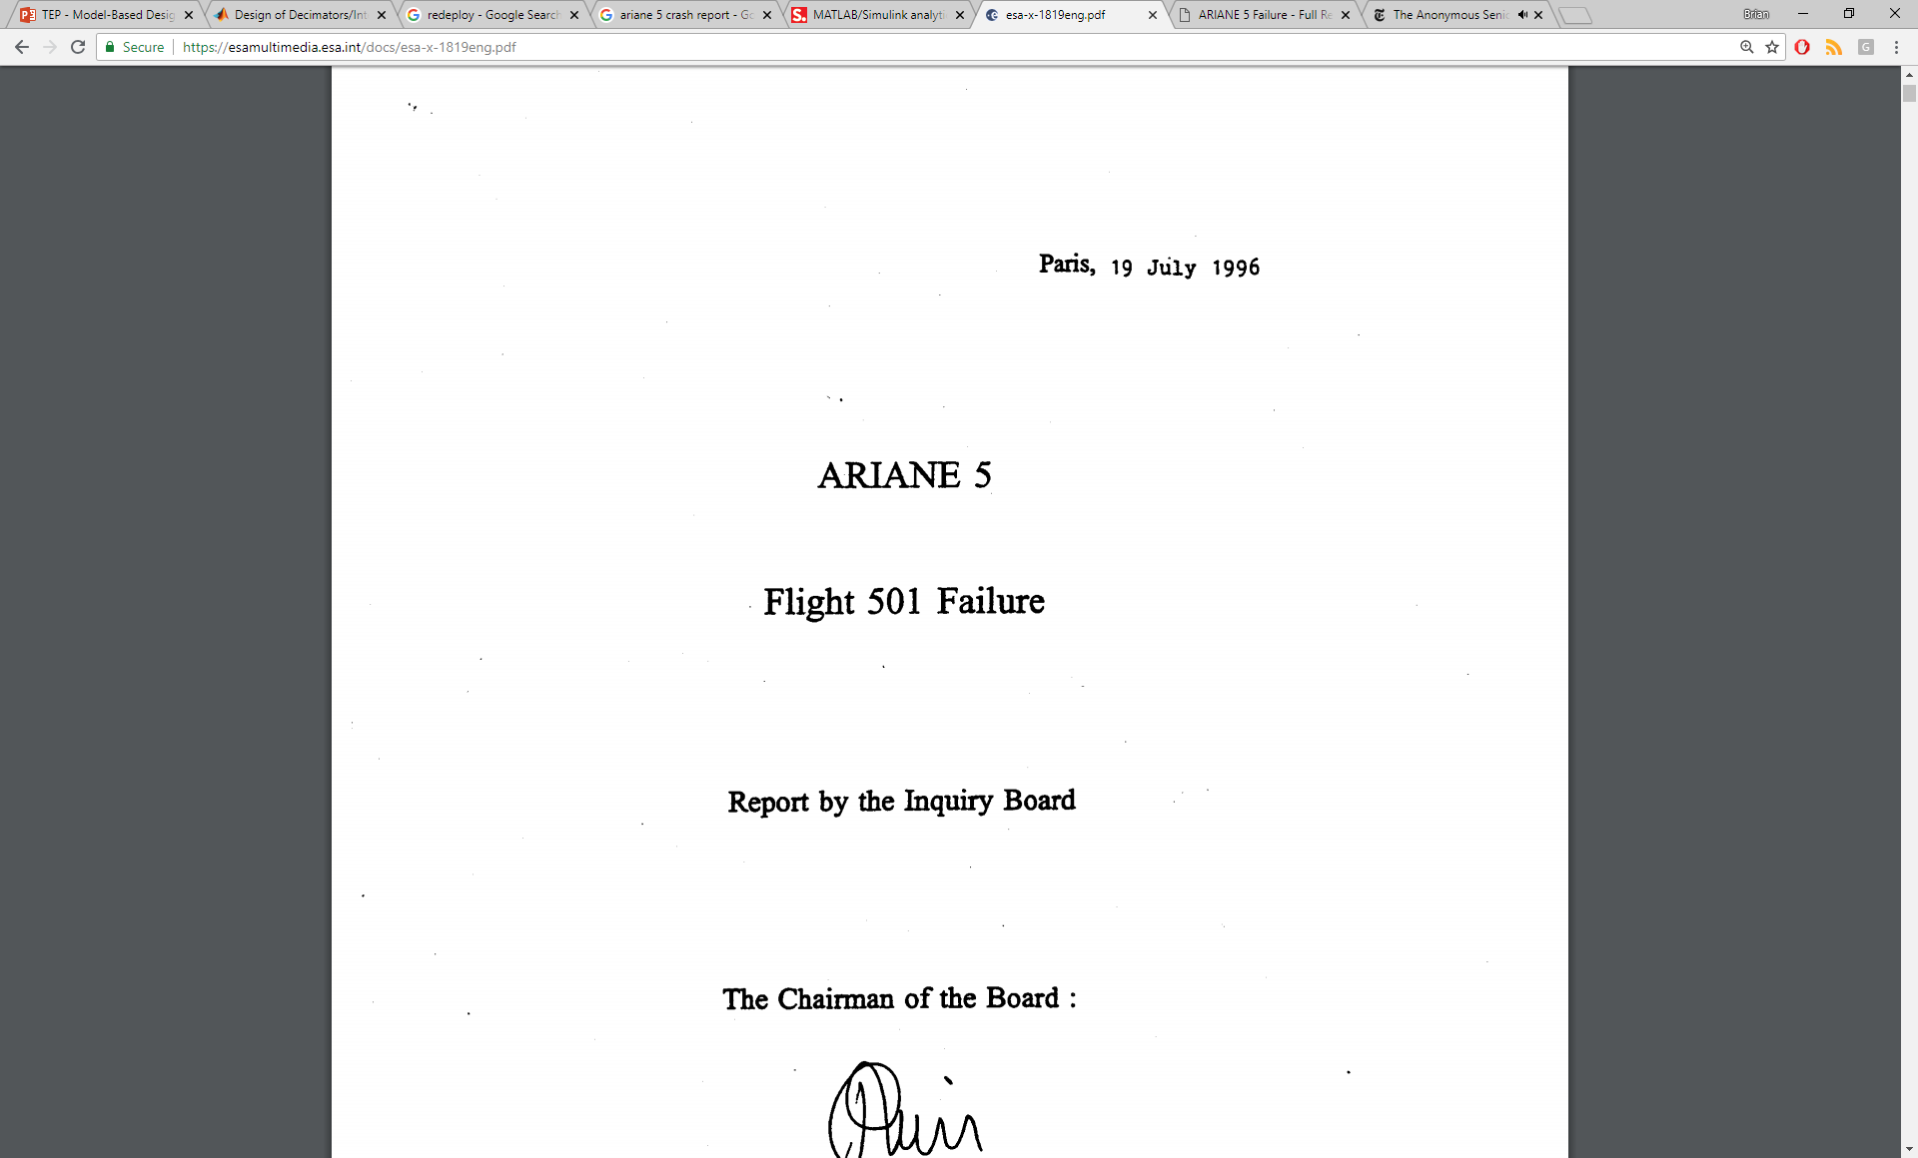
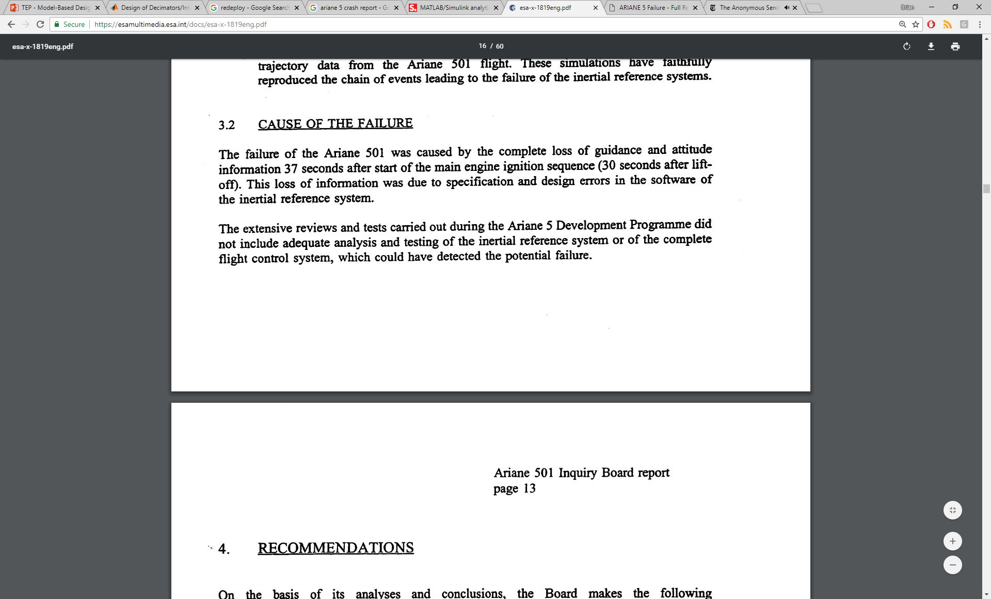
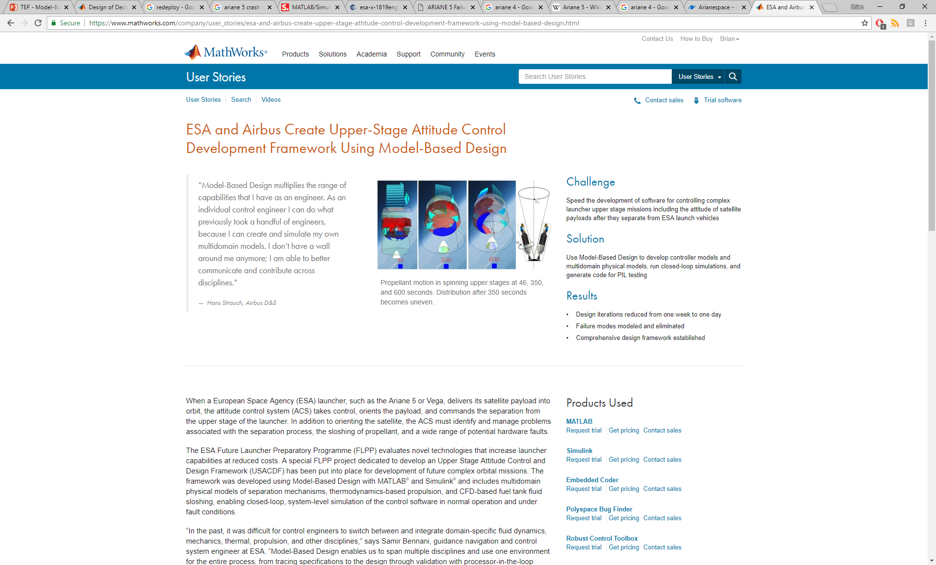
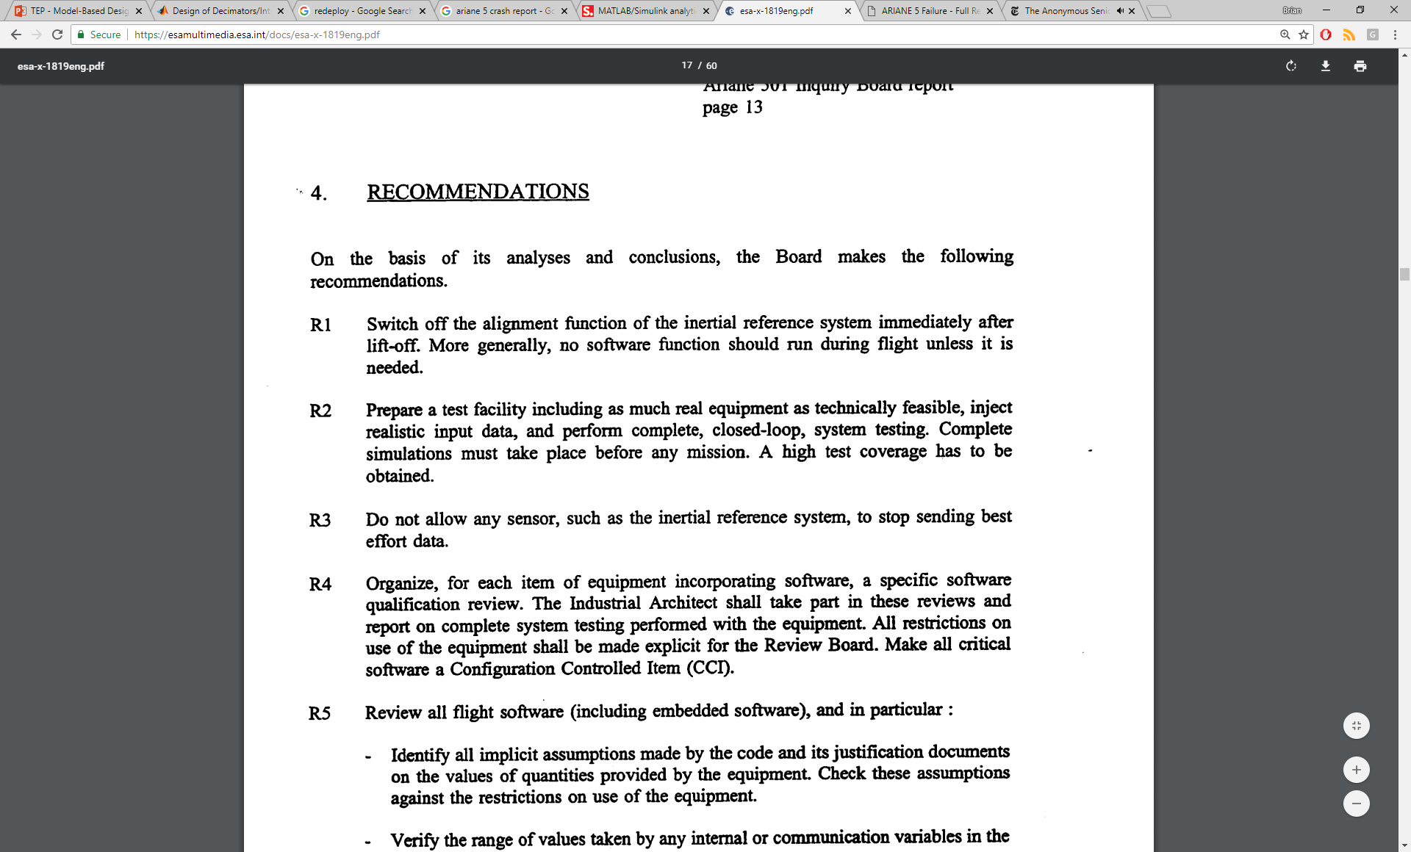
Ariane
Notes:
The failure resulted in a loss of more than US$370 million.

Slide 8
Shifting Left with Model-Based Design
Model-Based Design is a problem-solving method that treats the model as the single source of truth.
The model
is an executable requirements document.
lets us simulate many domains in one environment.
enables early, continuous testing.
serves as a source for code generation.
RESEARCH
REQUIREMENTS
DESIGN
System-level and
component-level models
TEST AND VERIFICATION
IMPLEMENTATION
Embedded software
and digital electronics
INTEGRATION
Notes:
Show quadcopter demo, explain how Simulink facilitates model-based design

Slide 9
Model-Based Design Enables Iteration
Test
Evaluate
Feynman problem-solving algorithm:
Write down the problem.
Think very hard.
Write down the answer.
Change design, requirements
To what degree does my problem-solving framework allow me to model, predict and improve?
Notes:
It’s rare that the first design is the best one. Design is normally an iterative process. Engineers come up with a design, implement it, and then test it. The results of these test then need to be evaluated before a new design change is made.

Slide 10

Phoenix Mars Lander: A Model-Based Design Success Story
Notes:
Phoenix was a robotic spacecraft on a space exploration mission on Mars under the Mars Scout Program. The Phoenix lander landed on Mars on May 25, 2008. Mission scientists used instruments aboard the lander to search for environments suitable for microbial life on Mars, and to research the history of water there. The total mission cost was about US $386 million, which includes cost of the launch.

Slide 11
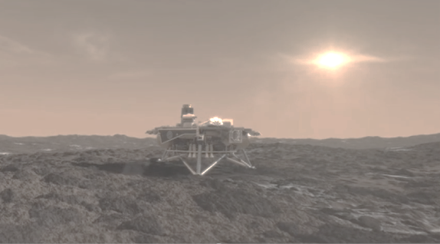
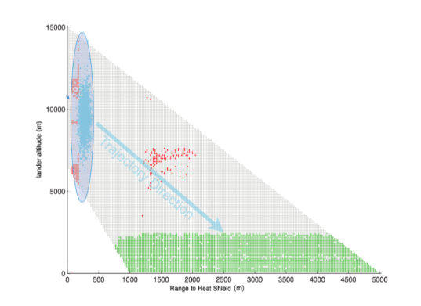
Phoenix
“Simulations using the high-fidelity radar model revealed that … the radar may report wildly incorrect altitudes.”
“This multi-body simulation provided sufficient confidence … to alleviate concerns.”
Locked on ground
Locked on heat shield
From Under the Radar: Trials and Tribulations of Landing on Mars.

Slide 12
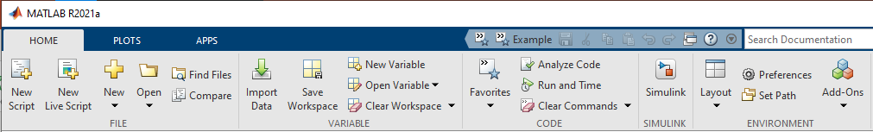
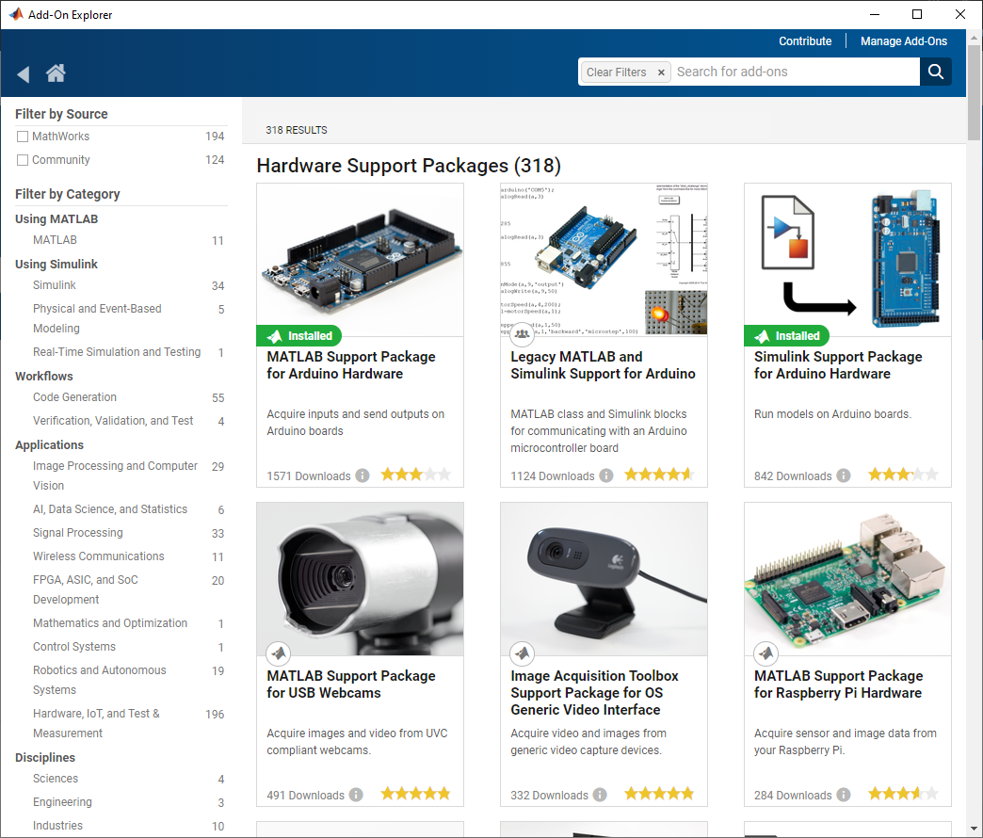
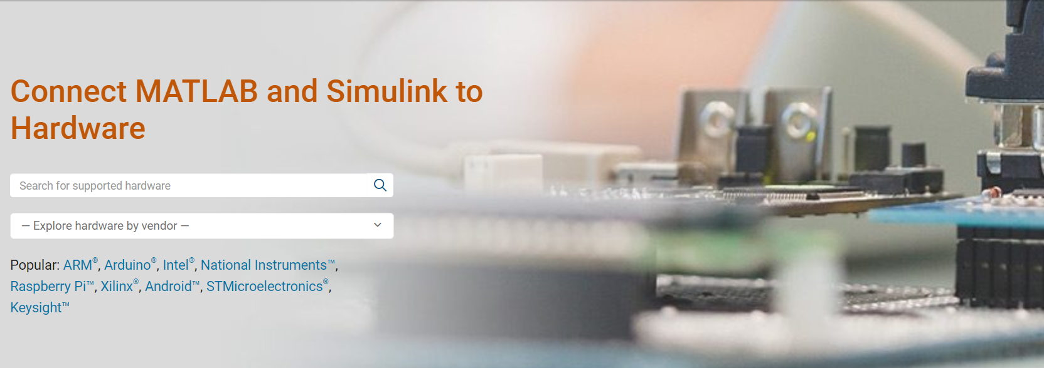
Where can you find hardware support packages?
https://www.mathworks.com/hardware-support/home.html

Slide 13
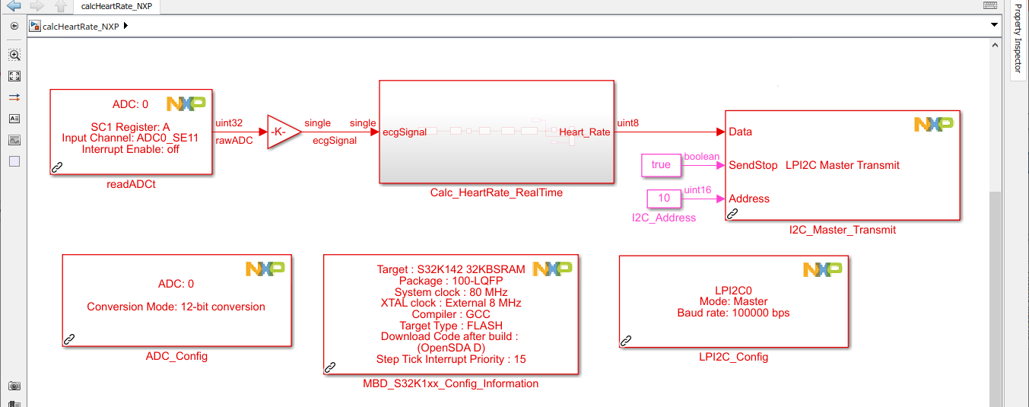
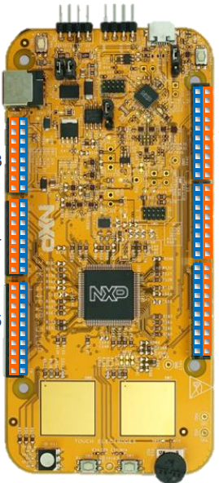
Working with Hardware Support Packages in Simulink
Algorithm Under Test
Device Driver Blocks

Slide 14
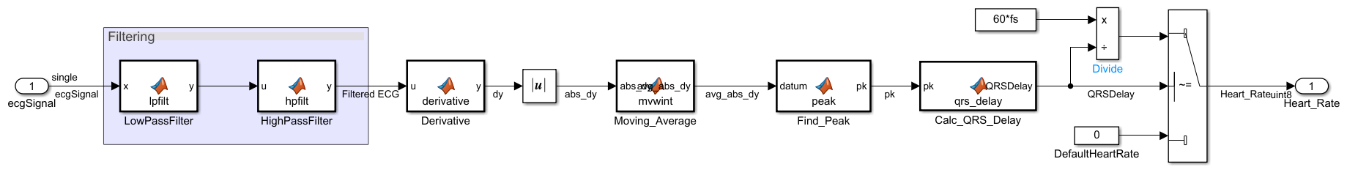
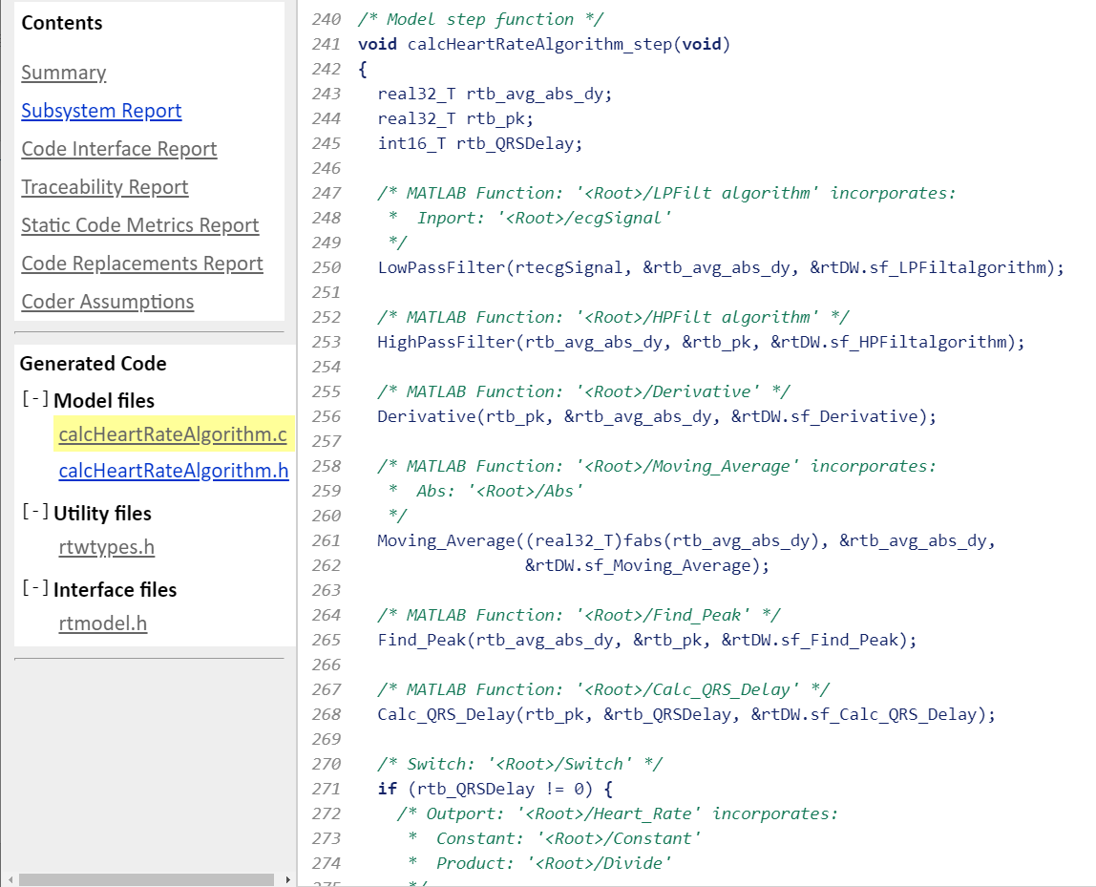
Generate Production Ready Code from Key Algorithms

Slide 15
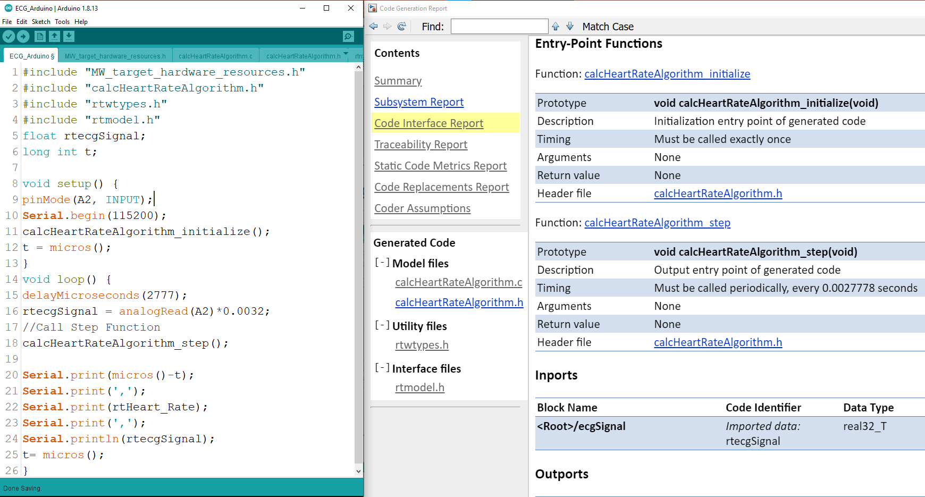
Integrating Generated Code with Hand Code Example: Arduino IDE Integration with Generated Code
#include generated .h files
Call Model_Init() Once at Initialization
Call Model_Step() every 2.77mS

Slide 16
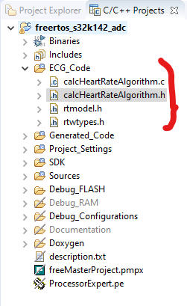
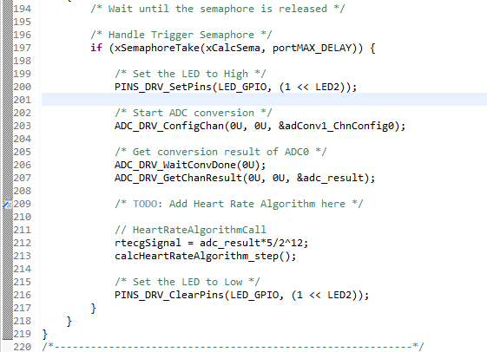
Integrating Generated Code with Hand Code Example: NXP S32 Design Studio IDE Integration with Generated Code
#include generated .c & .h files
Call Model_Step() in loop

Slide 17
Benefits of Prototyping on Evaluation Boards with Simulink
Kickoff your hardware+ software integration on Day-1
Focus on key algorithm design
Shorten design iterations due to code generation
Evaluate performance of your algorithms on final target hardware

Slide 18
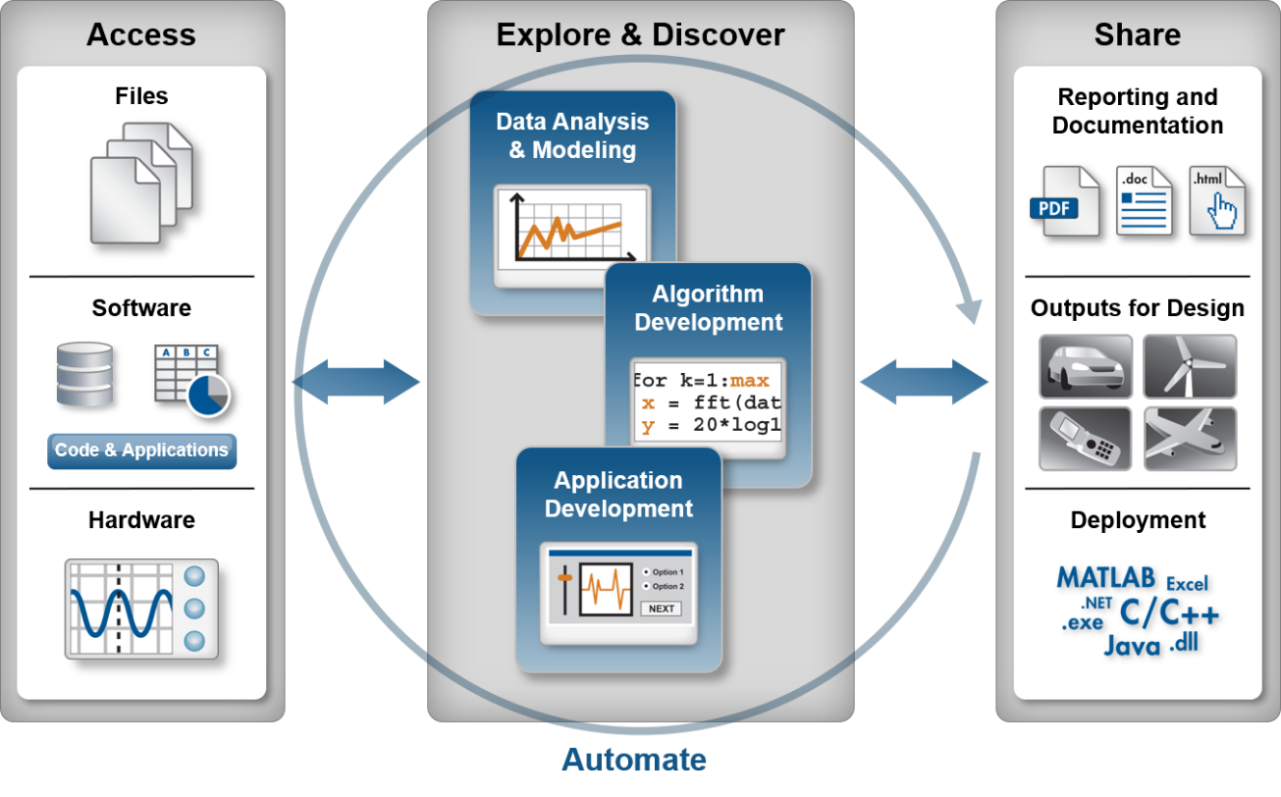

How does MATLAB fit into model-based design?
Technical computing & data analysis are an important part of the design process
Simulink is built on top of MATLAB
Use the right tool for the job
Technical Computing Workflow

Slide 19
MathWorks Support Mechanisms: Collaboration Ensures Success
Application Engineering
Pilot Engineering
Training
Consulting
Technical Support
Product questions
General support
Product/Capability demonstrations
Lunch-&-Learns, Workshops, WebEx’s, etc.
Evaluation support
Complimentary, guided support for adoption of new tools/processes
Deep engagement evaluations/ demonstrations
Paid training on specific tools and/or processes
On-site, web-based instructor lead, & self-paced online
Paid engagements (custom targets, tool customization, advisory services)
508-647-7000

